Slide 1
Multimedia Systems Lecture – 26
By
Dr. Priyambada Subudhi
Assistant Professor
IIIT Sri City

Slide 2
Arithmetic Coding
Unlike the methods discussed previously, arithmetic coding overcomes the requirement of every symbol to be coded independently.
In other words, coding every symbol was represented individually by a code, or a group was represented. Thus, a whole number of bits were required to encode a symbol (or symbol group).
Arithmetic coding overcomes this constraint by mapping an entire message to a real number between zero and one. This real number representing the entire message is coded as a binary number.
Arithmetic coding, thus, encodes a message entirely without assigning a fixed binary code to each symbol and, thereby, tends to produce better compression ratios.

Slide 3
The coding process uses a one-dimensional table of probabilities instead of a tree structure.
Given an alphabet of n symbols, there are an infinite number of messages that are possible. Each message is mapped to a unique real number in the interval [0,1).
The interval contains an infinite amount of real numbers, so it must be possible to code any message uniquely to one number in the interval.
The interval is first set at [0,1) for the first symbol, and then partitioned according to the symbol probabilities.

Slide 4
The algorithm can be outlined as follows:
Divide the interval [0,1) into n segments corresponding to the n symbols; the segment of each symbol has a length proportional to its probability. Each segment i has an upper bound U and lower bound L corresponding to the start of the segment and the end of the segment (U L Pi ).
Choose the segment that corresponds to the first symbol in the message string. This is the new current interval with its computed new upper and lower bounds.
Divide the new current interval again into n new segments with length proportional to the symbols probabilities and compute the new intervals accordingly.
From these new segments, choose the one corresponding to the next symbol in the message.
Continue Steps 3 and 4 until the whole message is coded.
Represent the segment’s value by a binary fraction in the final interval.

Slide 5
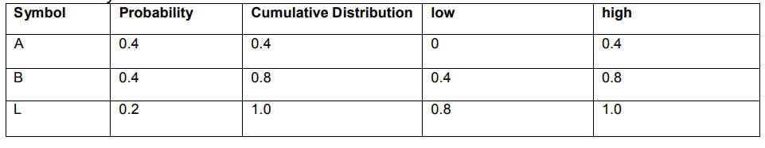
Example -1
Symbol statistics
Encoding Sequence BALL
Encode ‘B’: low=0+0.4*1=0.4 high=0+0.8*1=0.8
Encode ‘A’: low=0.4+(0)*(0.4)=0.4 high=0.4+(0.4)(0.4)=0.56
Encode ‘L’: low=0.4+(0.8)*(0.16)=0.528 high=0.4+(1.0)(0.16)=0.56
Encode ‘L’: low=0.528+(0.8)*(0.032)=0.5536 high=0.528+(1.0)(0.032)=0.56

Slide 6
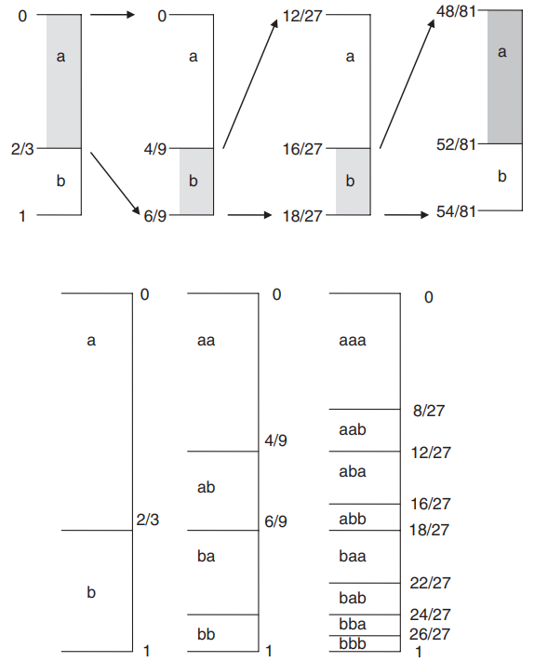
Example -2 Two symbols a, b having probabilities as follows P(a) 2/3, P(b) 1/3. To encode the message of length 4 “abba”

Slide 7
Adaptive Arithmetic Coding
Like adaptive Huffman coding, adaptive arithmetic coding is also possible.
The difference between the two is that there is no need to keep a tree for the codewords. The only information that needs to be synchronized is the frequency of occurrence of the symbols.
Unlike the previous example, the statistics table will be updated as symbols are encoded. The symbols are also updated when symbols are decoded.

Slide 8
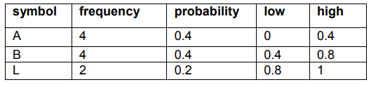
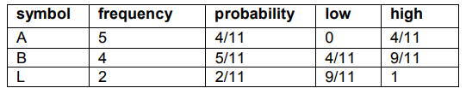
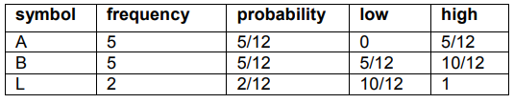
Initial table
Encode ‘B’: low=0+0.4*1=0.4 high=0+0.8*1=0.8
Table after ‘B’ is encoded
Encode ‘A’: low=0.4+(0)*(0.4)=0.4 high=0.4+(0.4)(4/11)=6/11
Table after ‘A’ is encoded

Slide 9
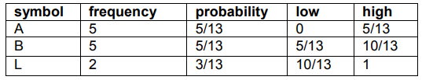
Encode ‘L’: low=0.4+(8/55)*(10/12)=86/165 high=0.4+(1.0)(8/55)=0.56
Table after ‘L’ is encoded
Encode ‘L’: low=(86/165)+(10/13)*(44/1815)=0.53986 high=(86/165)+(1)(44/1815)=0.54545

Slide 10
Assignment
A,B, and C, P(A) = 0.5, P(B) = 0.25 and P(C) =0.25, Find out the arithmetic code for BACA.

